Slide 1

Micromotion
Prediction of head movement based on previous movement and musical stimuli

Slide 2
Problem Statement
The project was based around data collected during a 2012 study conducted at the University of Oslo and resulted in a paper, Jensenius et al., "The Musical Influence on People's Micromotion when Standing Still in Groups", Proceedings of the 14th Sound and Music Computing Conference (2017).
Can the collected data be used to predict the amount people will move when hearing different types of stimuli

Slide 3
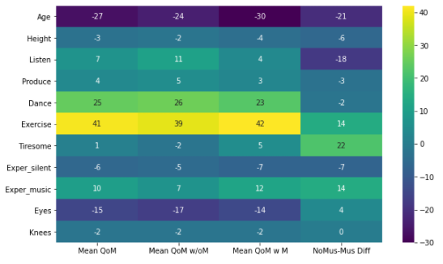
- Limited correlation to amount of movement - Removal of ex-post data
Demographics

Slide 4
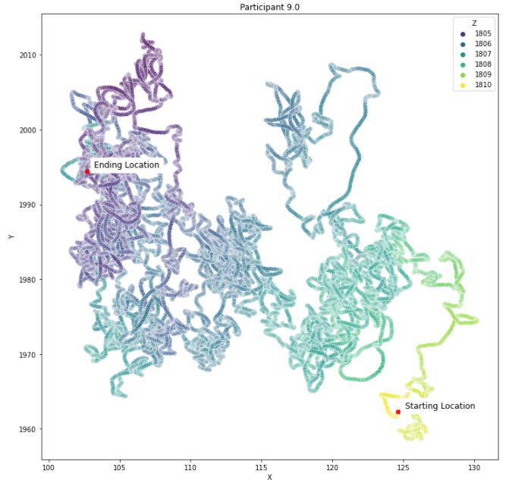
- Visual looking down at top of head - X – left to right, or side to side - Y – front to back - Z – height represented by color with lighter being higher and darker being lower
Motion

Slide 5
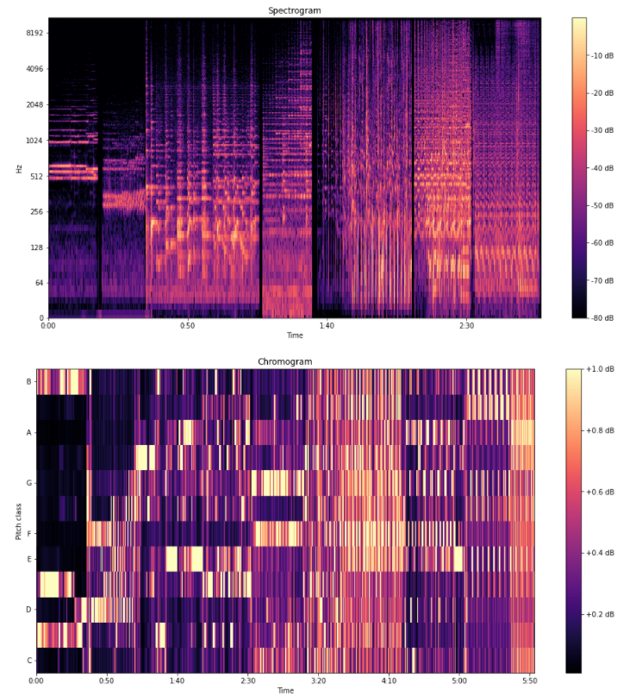

- Lento (#3) from György Ligeti Ten Pieces for Wind Quintet (20s) - Allegro con delicatezza (#8) from György Ligeti Ten Pieces for Wind Quintet (15s) - Adagio from Joaquin Rodrigo's Concierto de Aranjuez (40s) - Winter movement from Vivaldi's The Four Seasons (20s) - Left & Right by D'Angelo, featuring Method Man & Redman (35s) - Marcando la distancia by Manolito y su trabuco(20s) - Cubic by 808 State (30s)
Musical Stimuli

Slide 6
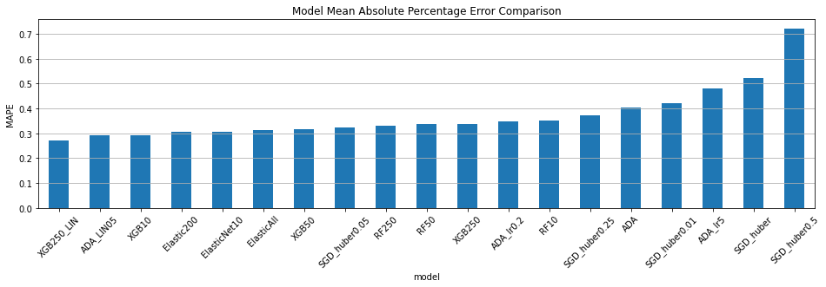
Model Performances

Slide 7
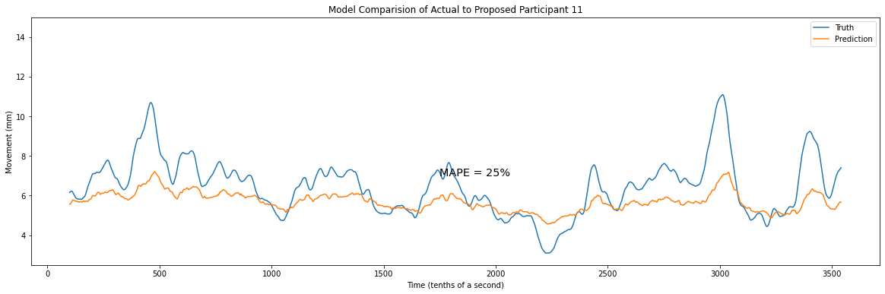
XGBoost Regressor – 250 Estimators – GBLinear Booster

Slide 8
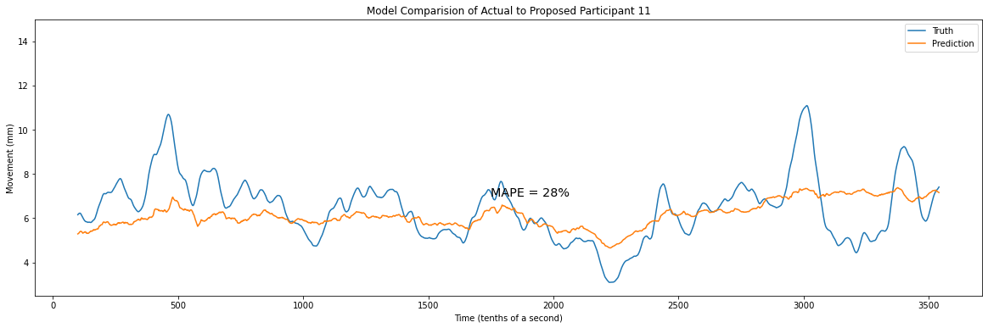
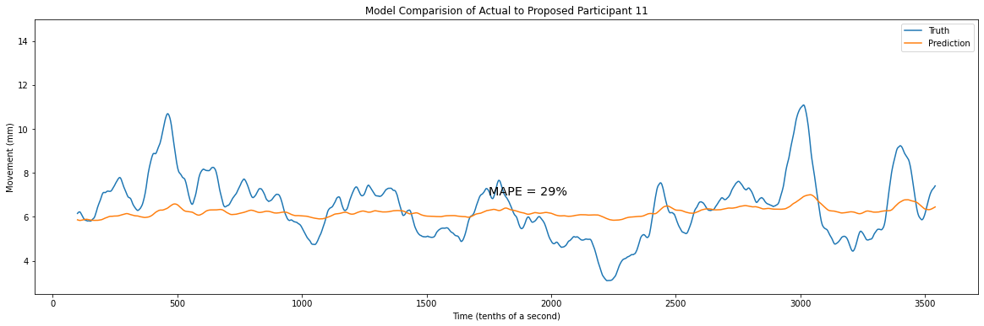
Linear Model Vs. Tree Based Model
RandomForest
ElasticNet

Slide 9
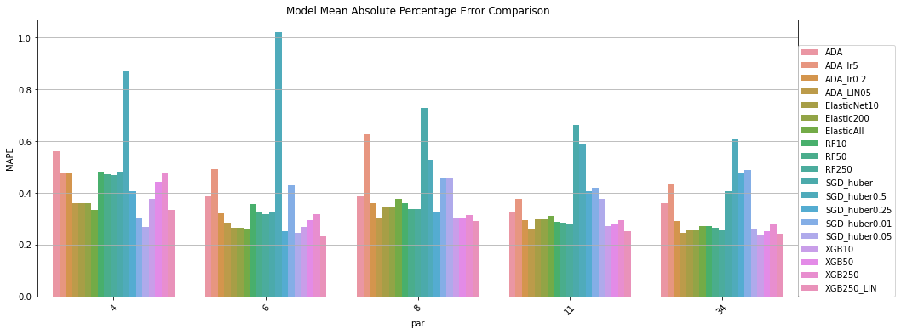
Participant Model Performance

Slide 10
Conclusions
- Linear models performed better on a metric basis
- Tree based models better caught the amplitude
- Different lines of inquery are still available for study such as:
Men vs. women
Types of music (segments) broken out
Training on data from 2/3 of participants fully and testing on remaining

